Slide 1
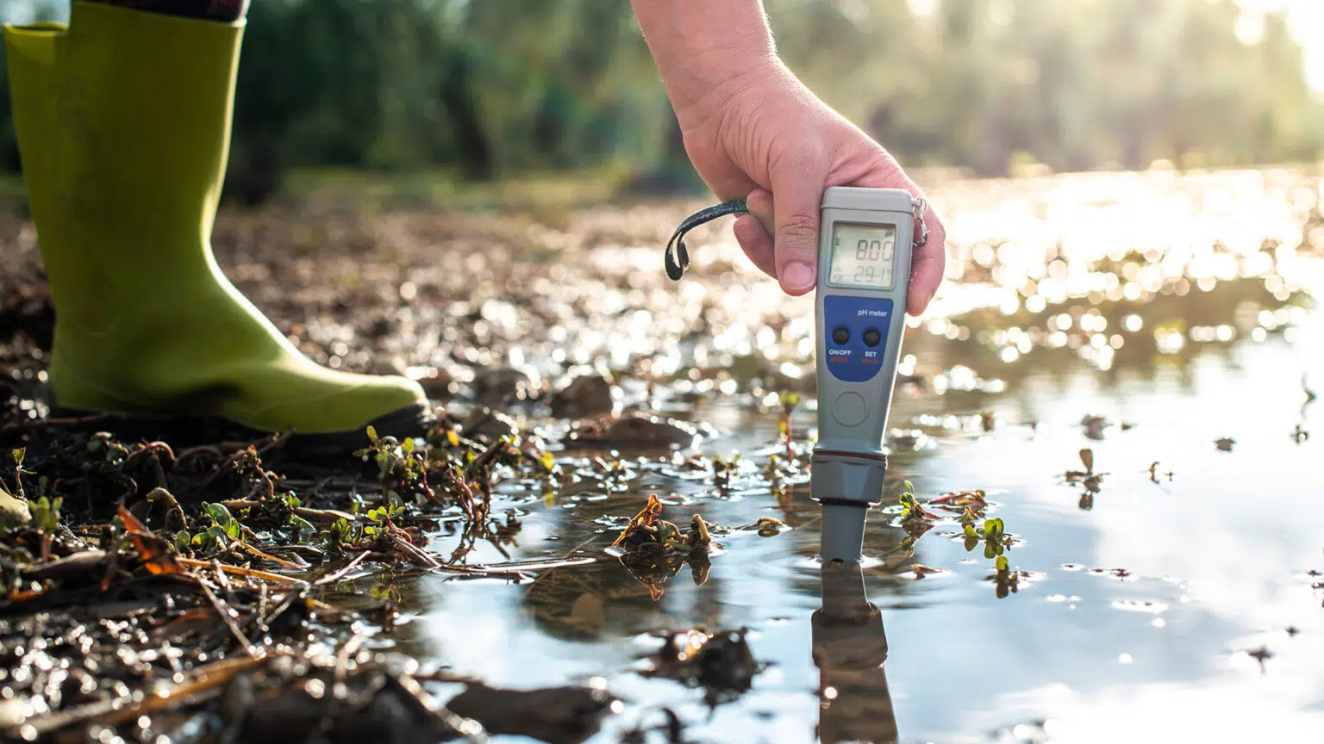

“Water Quality Analysis Using
Machine Learning”

Slide 2

MEET OUR TEAM
ZARNAB ZAFAR (TEAM LEAD)
WAJAHAT HUSSAIN
M. MUSTAFA SHAH AYESHA MAJEED
AISHA KAMRAN
SYEDA FATIMA
MOEED AHMAD

Slide 3
INTRODUCTION
OBJECTIVE
Develop a machine learning model to classify water samples as safe or unsafe for consumption based on key water quality indicators.
Aid stakeholders, such as water quality management authorities, by providing accurate predictions for ensuring safe drinking water.

Slide 4
BACKGROUND
Access to safe drinking water is a fundamental human right.
Ensuring water quality involves understanding various factors that affect potability.
Machine learning techniques can help analyze data on water quality and predict water potability.

Slide 5
Project Description
PROJECT OVERVIEW
Develop a predictive model using various machine learning algorithms.
Steps include data collection, preprocessing, feature engineering, model development, evaluation, optimization, and deployment.

Slide 6
SCOPE
Collecting and preprocessing a comprehensive dataset of water quality indicators.
Developing and training machine learning models.
Evaluating and optimizing the models for high accuracy and reliability.
Implementing the predictive model in a user-friendly application.

Slide 7
DATASET DETAILS
DATA SOURCE
The dataset used is sourced from Kaggle and contains data on major factors affecting water potability.
FEATURES AND TARGETS
Features: pH, hardness, dissolved oxygen, turbidity, presence of contaminants.
Target: A binary indicator of water potability (safe or unsafe).

Slide 8
DATA PRE-PROCESSING
Handling missing values.
Normalizing numerical features.
Encoding categorical variables.
Splitting the data into training, validation, and test sets.

Slide 9
METHODOLOGY
UNDERSTANDING WATER QUALITY PARAMETERS
Studied factors like pH, hardness, dissolved oxygen, and turbidity.
Explored relationships between these indicators and water potability.
DATA COLLECTION AND PRE-PROCESSING
Utilized a Kaggle dataset.
Handled missing values, normalized features, and encoded categorical variables.

Slide 10
FEATURE ENGINEERING
Analyzed the dataset to identify important features.
Created new features to enhance model performance.

Slide 11
MODEL DEVELOPMENT:
Explored algorithms: Logistic Regression, Decision Tree, Random Forest,K-Nearest Neighbors (KNN), Support Vector Machine (SVM), AdaBoost and XGBoost.
Trained multiple models, optimizing hyperparameters through cross-
validation.
Implemented techniques like feature selection and regularization.

Slide 12
MODEL EVALUATION AND OPTIMIZATION
Evaluated models using metrics: accuracy, precision, recall, F1-score, and AUC-ROC.
Compared the performance of different models.
Fine-tuned the best-performing model by adjusting hyperparameters and using ensemble methods.

Slide 13
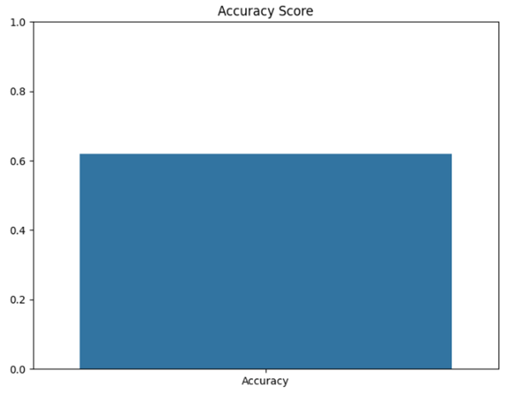
RESULTS
LOGISTIC REGRESSION MODEL RESULT
The accuracy score is 0.62 (62%).

Slide 14
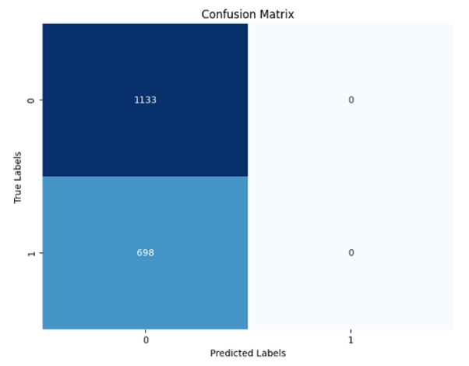
True Negatives (TN): 1133
False Positives (FP): 0
False Negatives (FN): 0
True Positives (TP): 698
A heatmap showing the confusion matrix.

Slide 15
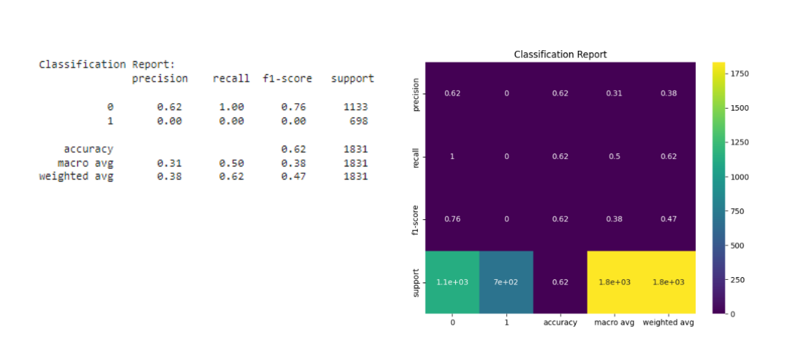
Class 0:
Precision: 0.62
Recall: 1.00
F1-score: 0.76
Support: 1133
Class 1:
Precision: 0.00
Recall: 0.00
F1-score: 0.00
Support: 698
Overall accuracy: 0.62

Slide 16
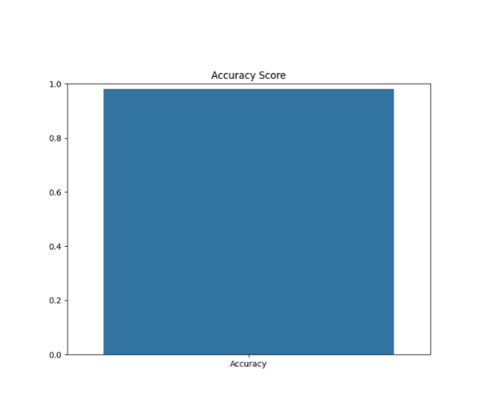
DECISION TREE MODEL RESULT
The accuracy score is 0.98 (98%).

Slide 17
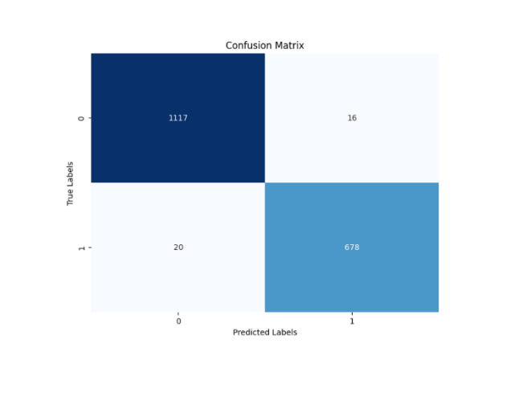
True Negatives (TN): 1117
False Positives (FP): 16
False Negatives (FN): 20
True Positives (TP): 678
A heatmap showing the confusion matrix.

Slide 18
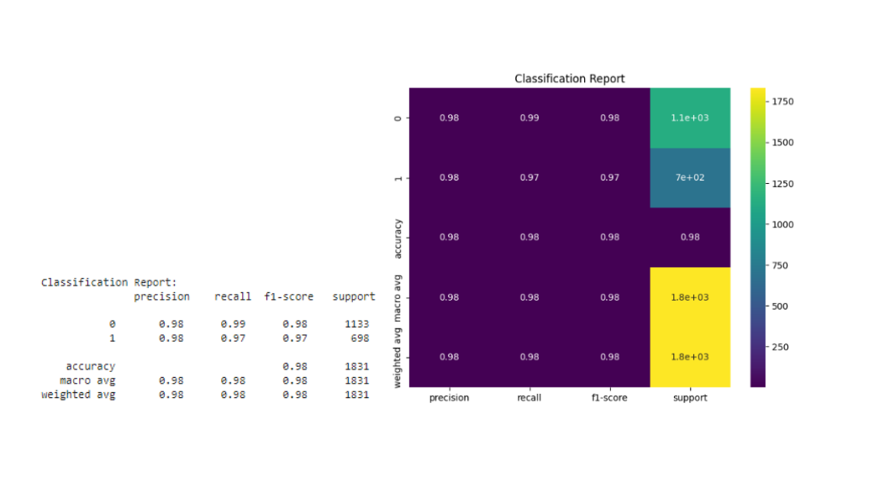
Class 0:
Precision: High
Recall: High
F1-score: High
Support: High
Class 1:
Precision: High
Recall: High
F1-score: High
Support: High
Overall accuracy: 0.98

Slide 19
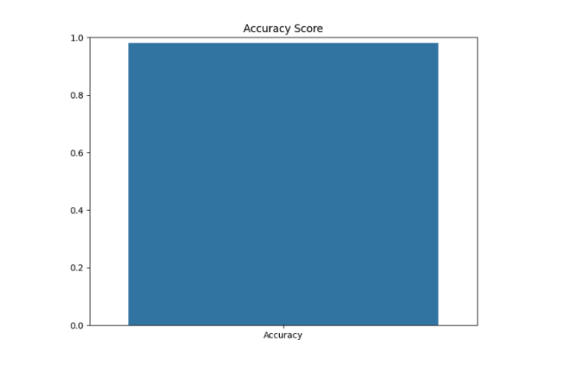
RANDOM FOREST MODEL RESULT
The accuracy score is 0.99 (99%).

Slide 20
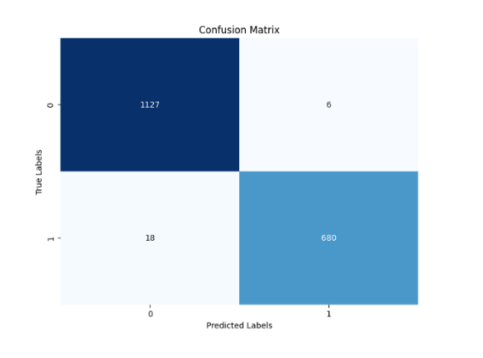
True Negatives (TN): High
False Positives (FP): Low
False Negatives (FN): Low
True Positives (TP): High
A heatmap showing the confusion matrix.

Slide 21
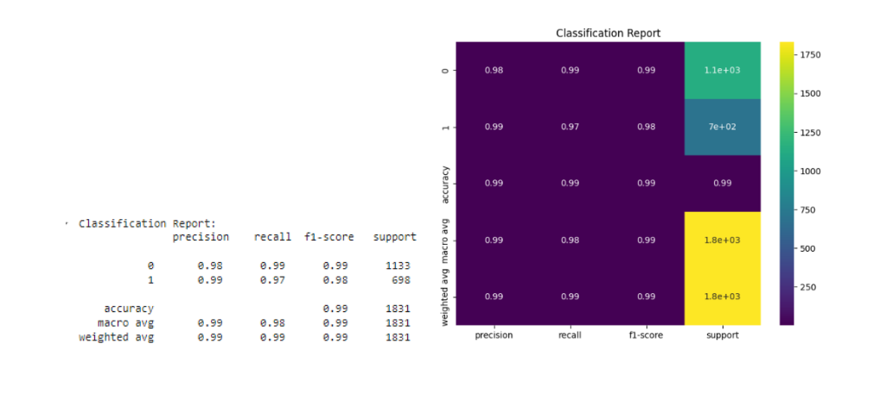
Class 0:
Precision: High
Recall: High
F1-score: High
Support: 1133
Class 1:
Precision: High
Recall: High
F1-score: High
Support: 698
Overall accuracy: 0.99

Slide 22
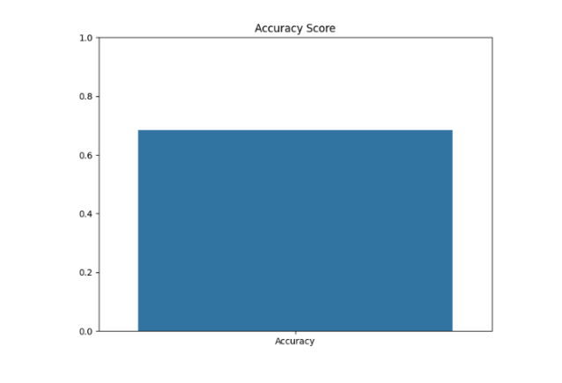
KNN MODEL RESULT
The accuracy score is 0.68 (68%).

Slide 23
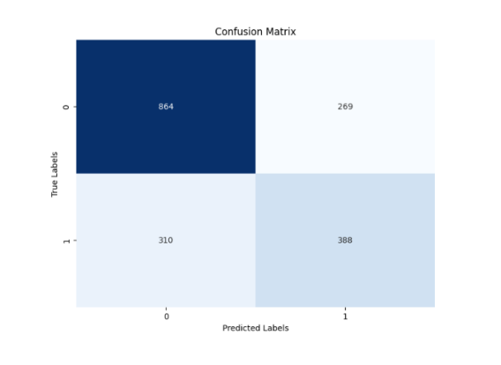
True Negatives (TN): 864
False Positives (FP): 269
False Negatives (FN): 310
True Positives (TP): 388
A heatmap showing the confusion matrix.

Slide 24
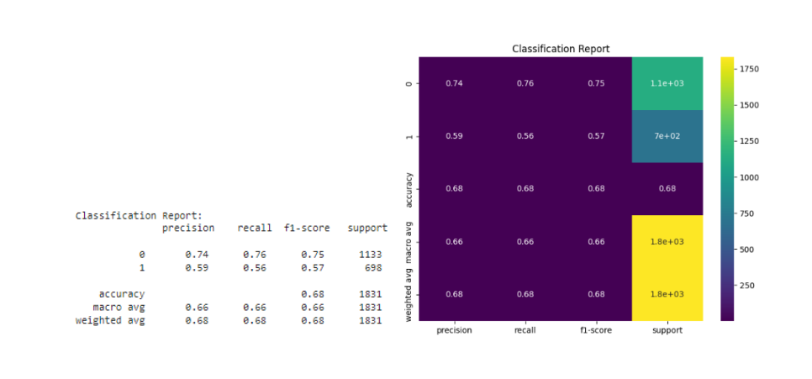
Class 0:
Precision: 0.74
Recall: 0.76
F1-score: 0.75
Support: 1133
Class 1:
Precision: 0.59
Recall: 0.56
F1-score: 0.57
Support: 698
Overall accuracy: 0.68

Slide 25
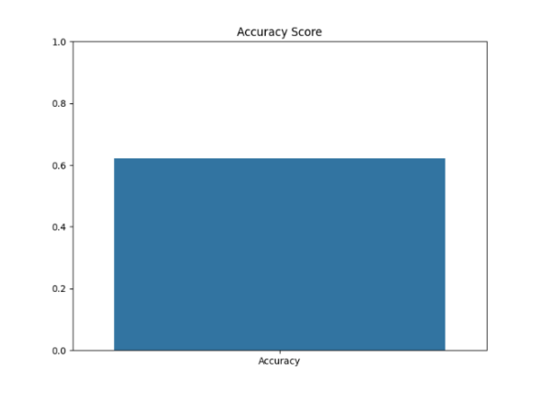
SVM MODEL RESULT
The accuracy score is 0.62 (62%).

Slide 26
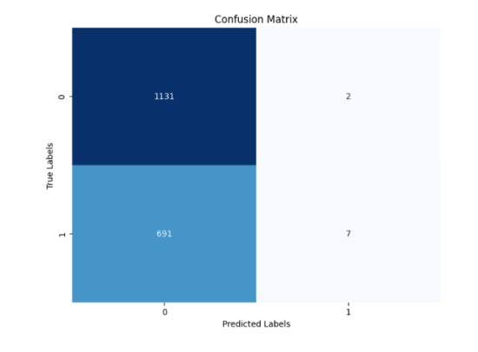
True Negatives (TN): 1131
False Positives (FP): 2
False Negatives (FN): 7
True Positives (TP): 691
A heatmap showing the confusion matrix.

Slide 27
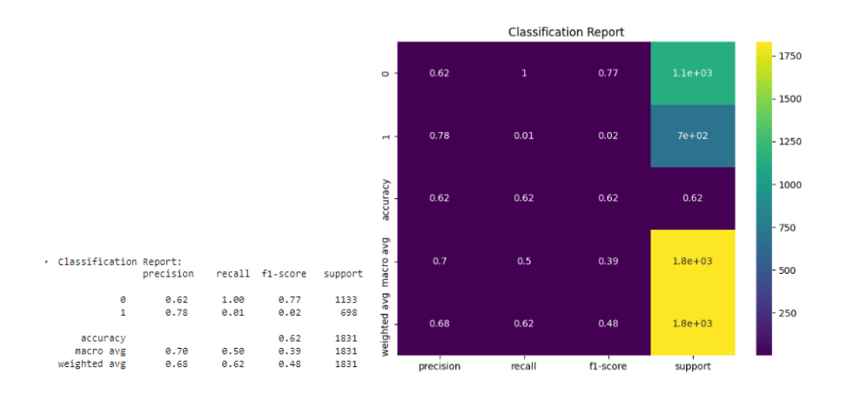
Class 0:
Precision: 0.62
Recall: 1.00
F1-score: 0.77
Support: 1133
Class 1:
Precision: 0.78
Recall: 0.01
F1-score: 0.02
Support: 698
Overall accuracy: 0.62

Slide 28
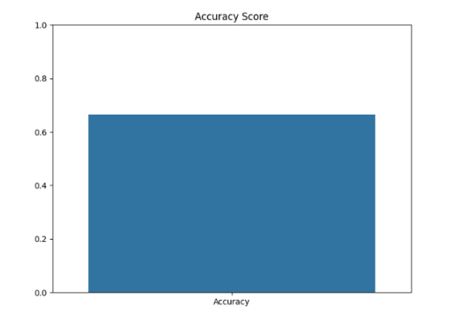
ADA BOOST
The accuracy score is 0.66 (66%).

Slide 29
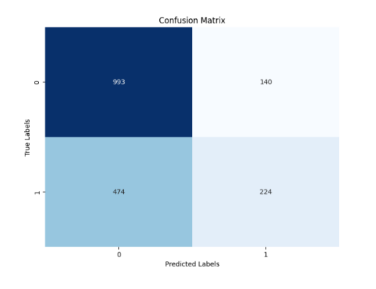
True Negatives (TN): 993
False Positives (FP): 140
False Negatives (FN): 474
True Positives (TP): 224
A heatmap showing the confusion matrix.

Slide 30
Class 0:
Precision: 0.68
Recall: 0.88
F1-score: High
Support: 1133
Class 1:
Precision: 0.62
Recall: 0.32
F1-score: Low
Support: 698
Overall accuracy: 0.66

Slide 31
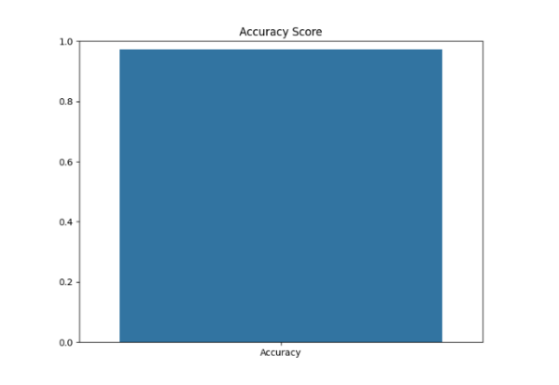
XG BOOST MODEL RESULT
The accuracy score is 0.97 (97%).

Slide 32
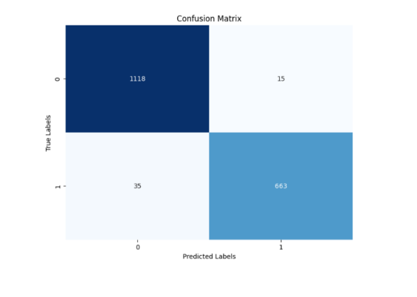
True Negatives (TN): 1118
False Positives (FP): 15
False Negatives (FN): 35
True Positives (TP): 663
A heatmap showing the confusion matrix.

Slide 33
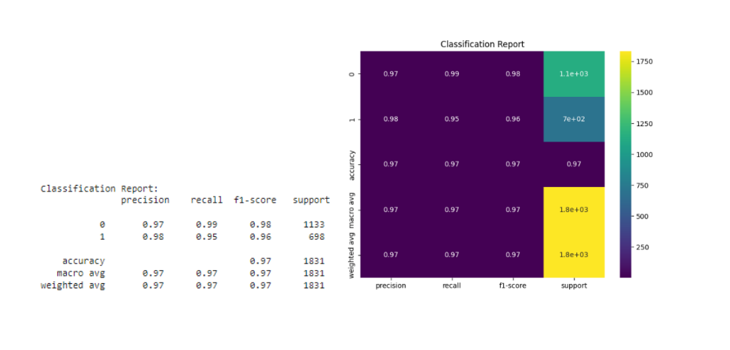
Class 0:
Precision: High
Recall: High
F1-score: High
Support: 1133
Class 1:
Precision: High
Recall: High
F1-score: High
Support: 698
Overall accuracy: 0.97

Slide 34
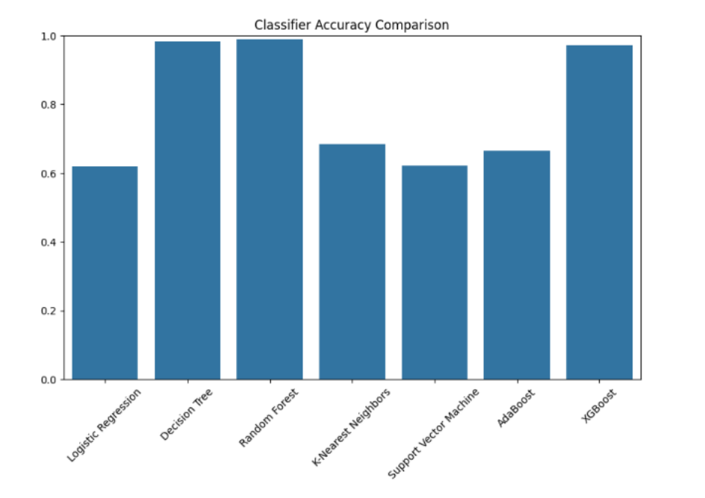
MODELS COMPARISION AND FINDING THE BEST ONE
Accuracy Comparison:
A bar chart comparing the accuracy of different models.
Logistic Regression: 0.62
Decision Tree: 0.98
Random Forest: 0.99
KNN: 0.68
SVM: 0.62
AdaBoost: 0.66
XGBoost: 0.97
Best Model:
Random Forest with the highest accuracy (0.99).

Slide 35
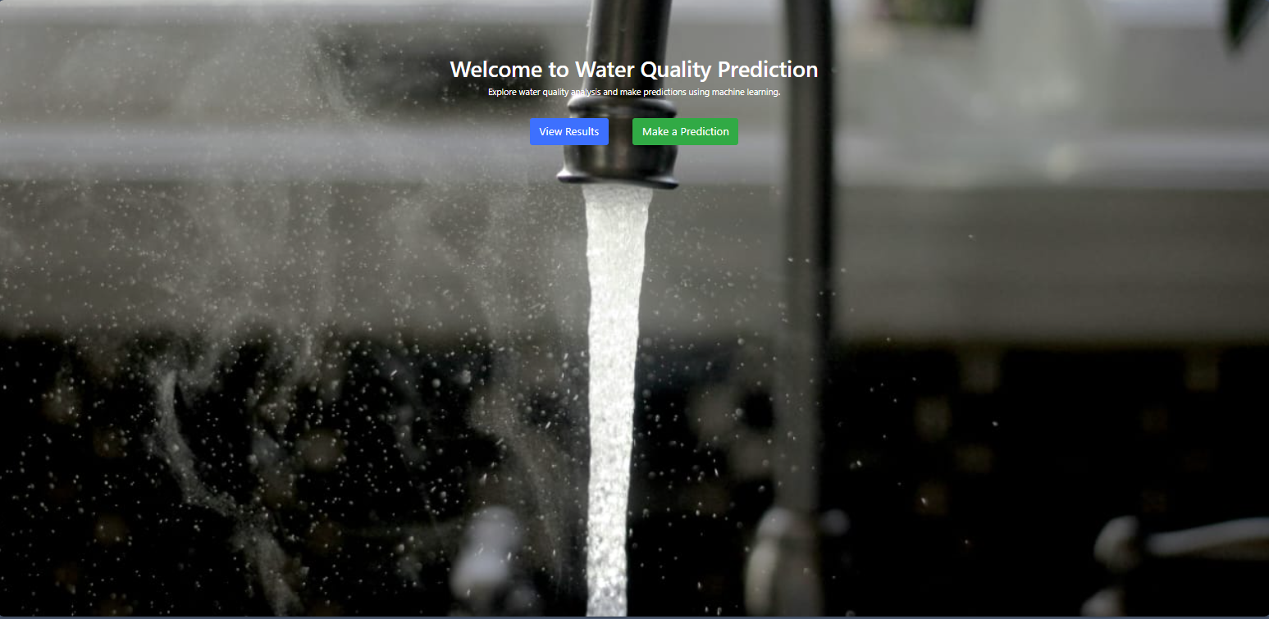
DEPLOYMENT

Slide 36
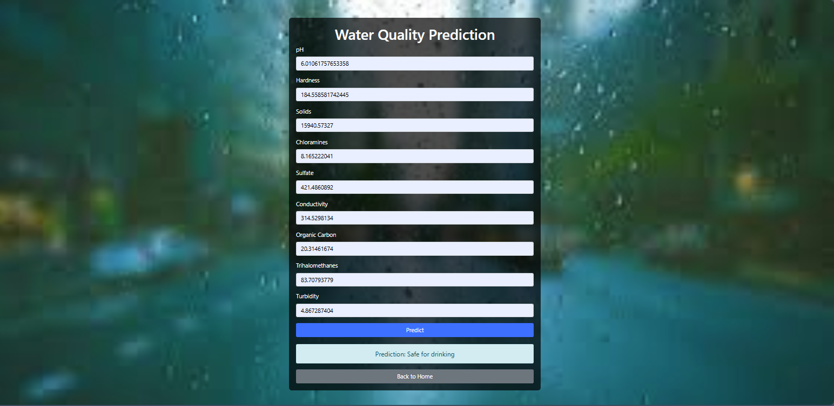

Slide 37
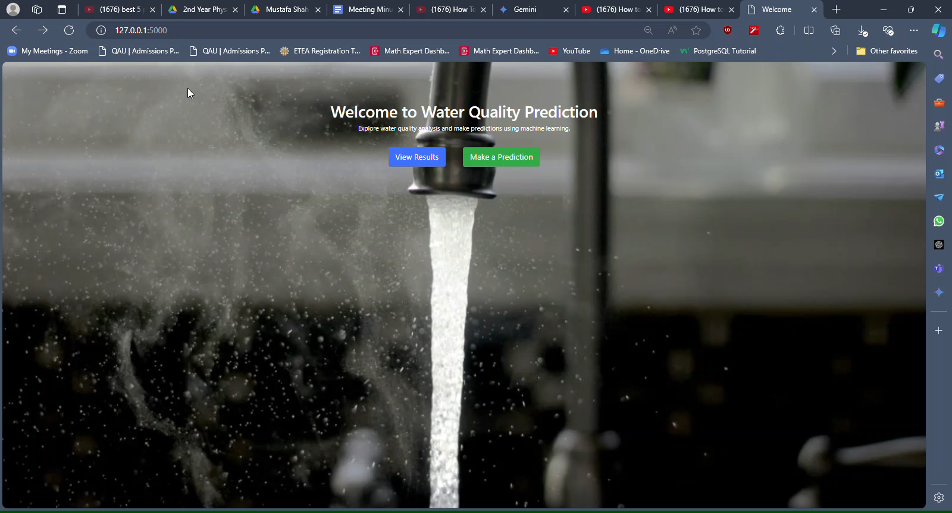

Slide 38


